Slide 1

Pentium 4

Slide 2

Introduction
The Pentium 4 is a seventh-generation x86 architecture microprocessor produced by Intel and was their first all-new CPU design, called the NetBurst architecture, since the Pentium Pro of 1995.
The P4 processor has a viable clock speed that now exceeds 2 gigahertz
Usage : Intel Pentium 4 Processor is designed to deliver performance across usages—such as image processing, video content creation, games and multimedia—where end-users can truly appreciate the performance.
Unlike the Pentium II, Pentium III, and various Celerons, the architecture owed little to the Pentium Pro/P6 design,

Slide 3
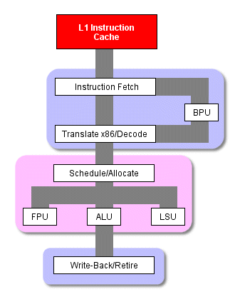
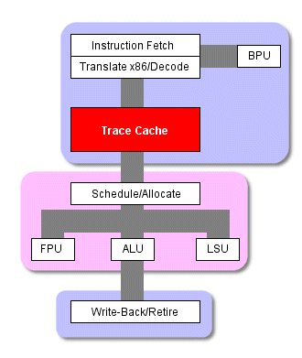
Comparison with other processor’s execution path
Normal x86 processor's critical
execution path The P4's critical execution path

Slide 4
Comparison with other processor’s execution path
In a conventional x86 processor like the PIII or the Athlon
x86 instructions make their way from the instruction cache into the decoder
multiple smaller, more uniform, more easily managed instructions (µops) are actually what the out-of-order execution engine schedules, executes, and retires
instruction translation happens each time an instruction executed
In Pentium 4
The P4's instruction cache takes translated, decoded µops that are primed and ready to be sent straight out to the OOO execution engine
Traces: P4 arranges µops into little mini-programs(traces). These traces, and not the x86 code that was produced by the complier, are what the P4 executes whenever there's an L1 cache hit.
cache hit : is over 90% of the time.

Slide 5
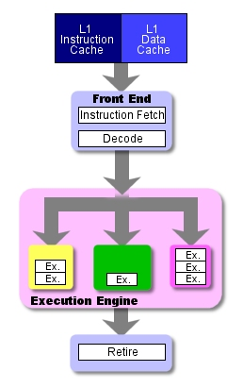
Basic Architecture of the P4
……. Intel NetBurst micro-architecture

Slide 6
Overview of the Intel NetBurst Micro-architecture Pipeline
a 20-stage pipeline : which boosts performance by increasing processor frequency
a rapid-execution engine : which doubles the core frequency and reduces latency by enabling each instruction to be executed in a half (rather than a whole) clock cycle.
a 400 MHz system bus : which enables transfer rates of 3.2 gigabytes per second (GBps);
an execution trace cache : which optimizes cache memory efficiency and reduces latency by storing decoded sequences of micro-operations.
improved floating point and multimedia unit and advanced dynamic execution: which enable faster processing for especially demanding applications, such as digital video, voice recognition, and online gaming.

Slide 7
Pipeline
The pipeline of the Intel NetBurst micro-architecture contain :
• the in-order issue front end
• the out-of-order superscalar execution core
• the in-order retirement unit.
Main features :
• L1 cache is split up, with the instruction cache actually sitting inside the front end
• This oddly located the trace cache, is one of the P4's most innovative and important features.
Uses the branch prediction:
The trace cache actually uses branch prediction when it builds a trace so that it can splice code from the branch that it thinks the program will take right into the trace behind the code that it knows the program will take

Slide 8
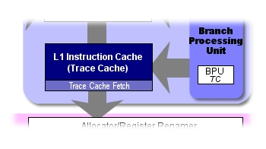
P4's architecture execution steps
Here's a breakdown of the various stages:
Stages 1 and 2 - Trace Cache next Instruction Pointer:
Stages 3 and 4 - Trace Cache Fetch: These two stages fetch an instruction from the trace cache to be sent to the OOO execution engine.
Stage 5 - Drive: This is the first of two of Drive stages in the P4's pipeline, each of which is dedicated to driving signals from one part of the processor to the next

Slide 9
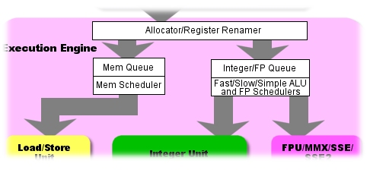
P4's architecture execution steps
Stages 6 through 12
Stages 6 through 8 - Allocate and Rename: This group of stages handles the allocation of microarchitectural register resources.
Stage 9 - Queue: memory uop queue and an arithmetic uop queue

Slide 10
P4's architecture execution steps
Stages 10 through 12
Schedule:
Memory Scheduler
Fast ALU Scheduler
Slow ALU/General FPU Scheduler - Schedules the rest of the ALU functions and most of the floating-point functions.
Simple FP Scheduler - Schedules simple FP operations and FP memory operations.
Stages 13 and 14 - Dispatch:
In these two stages instructions travel through one of the four dispatch ports for execution.

Slide 11
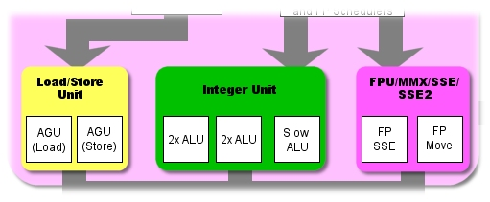
P4's architecture execution steps
Stages 13 through 17
Stages 15 and 16 - Register Files: After traveling through the dispatch ports in the last two stages, the instructions spend these two stages being loaded into the register files for execution.
Stage 17 - Execute: In this stage, the instructions are actually executed by the execution engine's functional units.

Slide 12
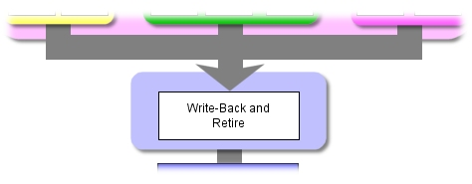
P4's architecture execution steps
Stages 18 through 19
Stage 18 - Flags:
Stage 19 - Branch Check: Here's where the P4 checks the outcome of a conditional branch to see if it has just wasted 19 cycles of its time executing some code that it'll have to throw away.

Slide 13
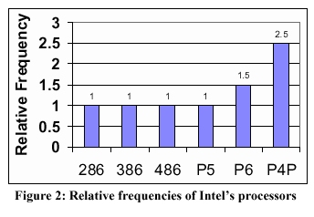
Relative frequencies
286, Intel386 ™, Intel486 ™ and Pentium ® (P5)processors :
> similar pipeline depths
> run at similar clock rates if they were all implemented on the same silicon process technology.
> similar number of gates of logic per clock cycle
The P6 micro architecture
lengthened the processor pipelines, allowing fewer gates of logic per pipeline stage, which delivered significantly higher frequency and performance.
The Net Burst micro architecture (The Microarchitecture of the Pentium 4 Processor) was designed to have an even deeper pipeline (about two times the P6 microarchitecture) with even fewer gates of logic per clock cycle to allow an industry-leading clock rate.

Slide 14
References
http://www.intel.com/
http://arstechnica.com/articles/paedia/cpu/p4andg4e.ars/
The Unabridged Pentium 4: IA32 Processor Genealogy

